Slide 1


Slide 2

Starmark specialises in providing absolute quality of Customised Products, Stationery, Office Supplies
and Print Solutions.
.

Slide 3

We are a customer focused business and assure high quality hassle-free services to our customers. With affordable pricing, attractive offers and
100% genuine products, we are adept to make your experience simple
and remarkable.
Starmark ensures the right processes, finishes and materials are used
every single time. Our fervour is to deliver incomparable services and
utilize our knowledge to make sure the finest quality products reach our customers.

Slide 4
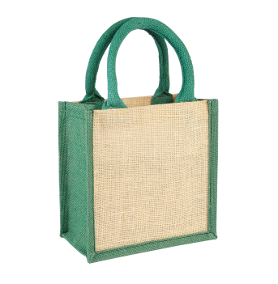

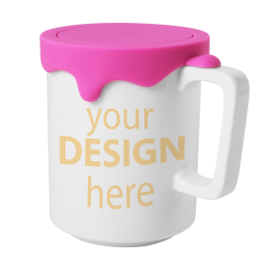
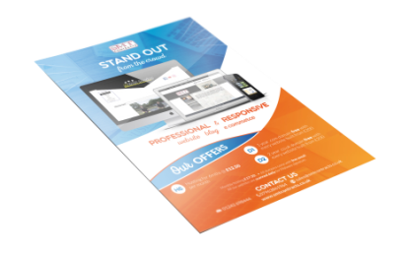
Our Services
Corporate Stationery
Customised Products
Experience the ease of gifting with customised printed products. Get Custom printing of the logo and name of your company.
Eco Friendly Item
Whether full colour or one colour, short run or long run, we specialise in providing unparalleled printing solutions
Printing
Be it from the scratch or working with existing designs, we offer bespoke creative solutions that suit your brand.
We supply everything
from the usual business stationery essentials to
the more unusual items and everything in
between.

Slide 5

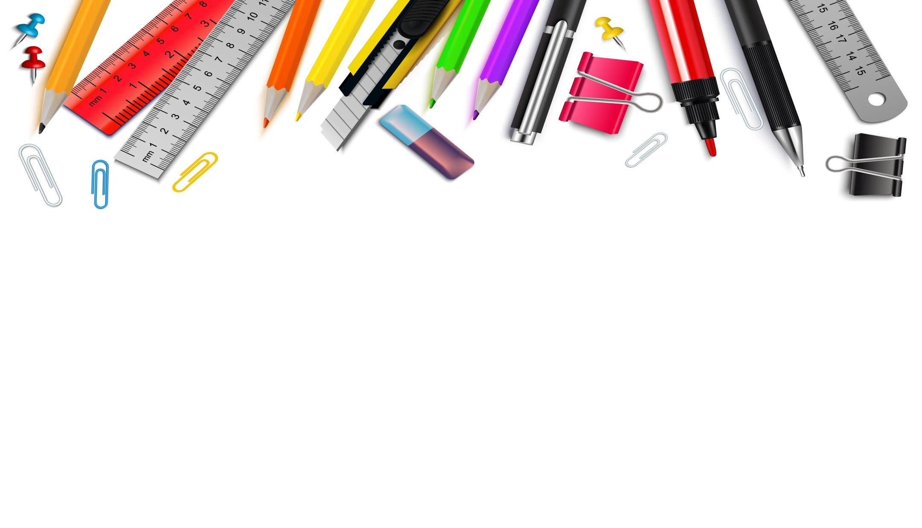
Corporate Stationery
We offer an extensive range of high quality corporate stationery‒Notebooks, Office books, Pens &
Writing Instruments, Highlighters & Markers, Desk Organisers & Accessories, Files & Folders,
Measuring instruments, Magnifying lenses, Labels & Notes, Copier & Printing papers, and much more. With affordable pricing, attractive offers and 100% genuine products, we strives to make your buying
experience simple and remarkable.

Slide 6




Customised Products
Personalized gifts are a gesture of thoughtfulness as they involve an extra effort of putting a personal touch in it. Experience the ease of gifting with customised printed things like key chains, wall clocks,
flash drives, mugs, photo frames, and lot more with Starmark.

Slide 7
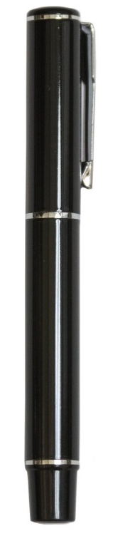
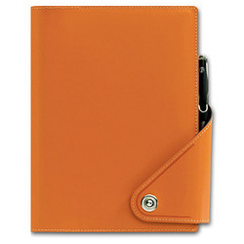
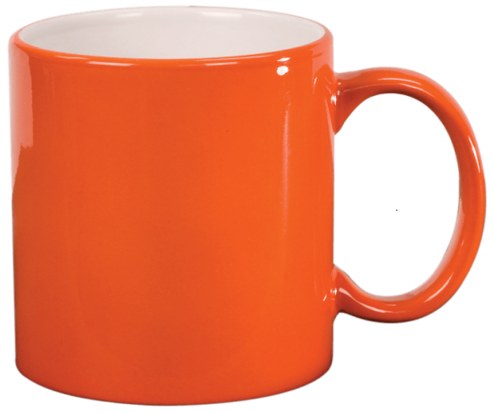
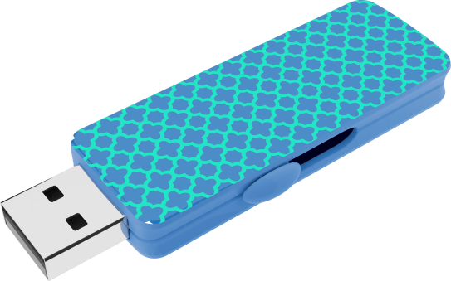
Customised Products
YOUR LOGO HERE
YOUR LOGO HERE
YOUR LOGO HERE
YOUR LOGO HERE

Slide 8

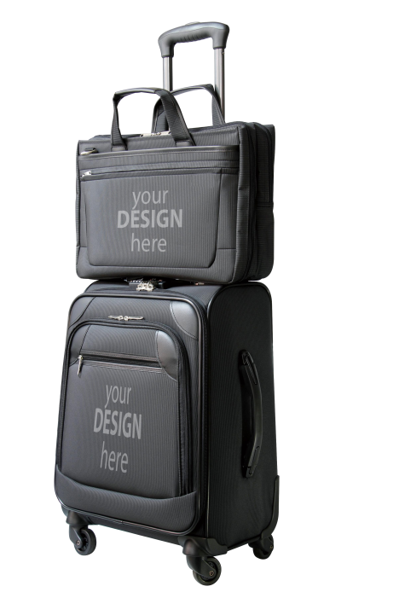
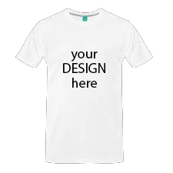
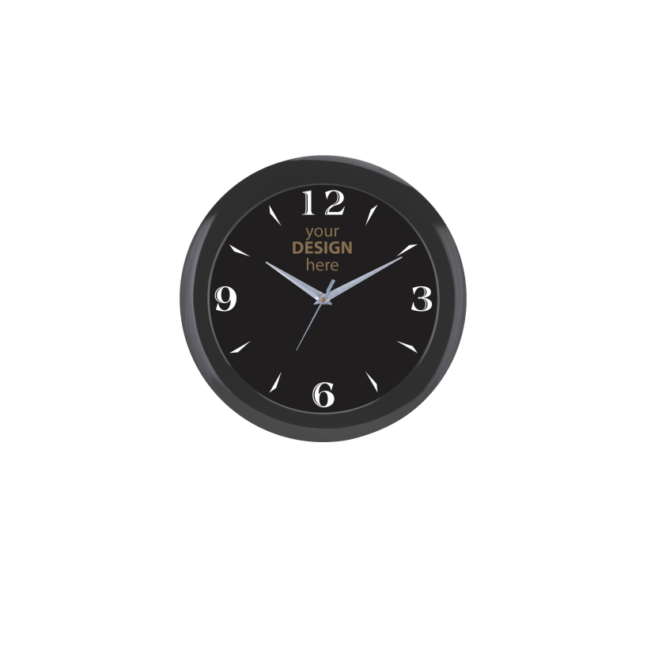
Customised Products

Slide 9
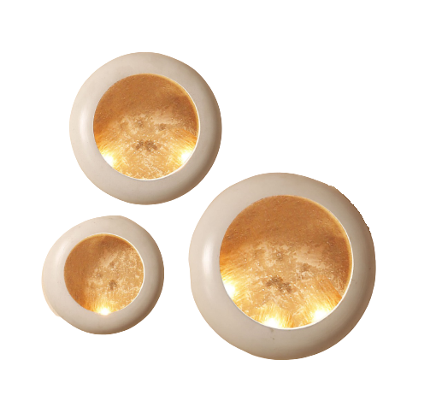


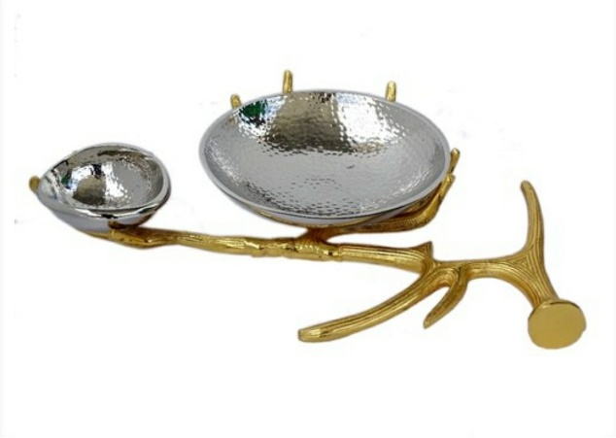
Customised Products
YOU LOGO HERE

Slide 10
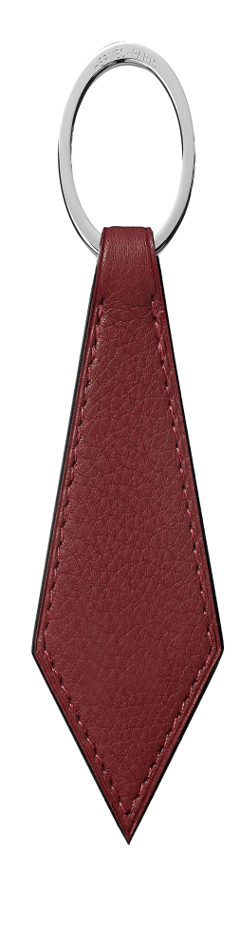

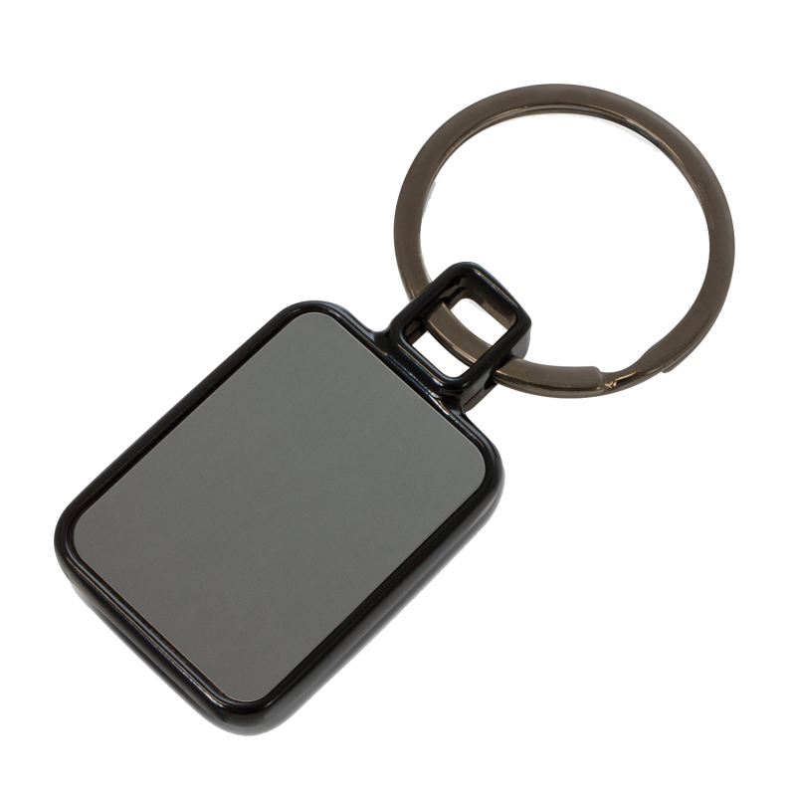
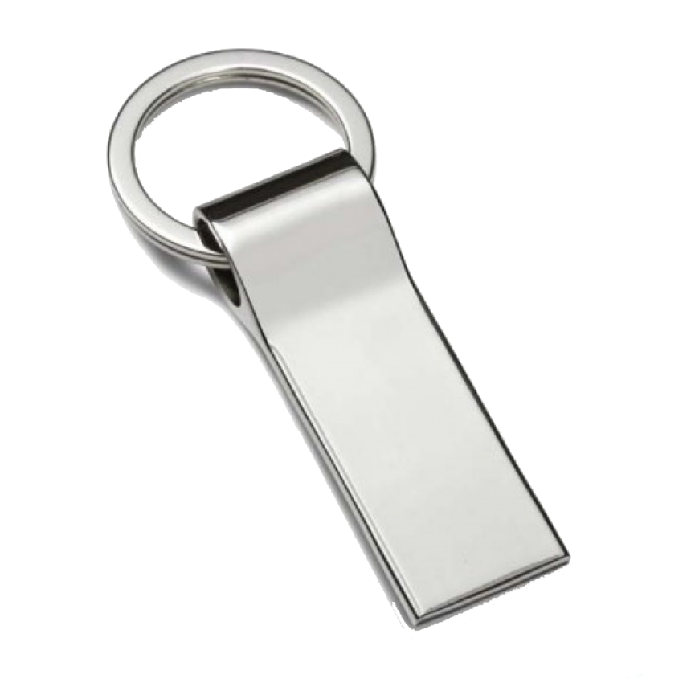
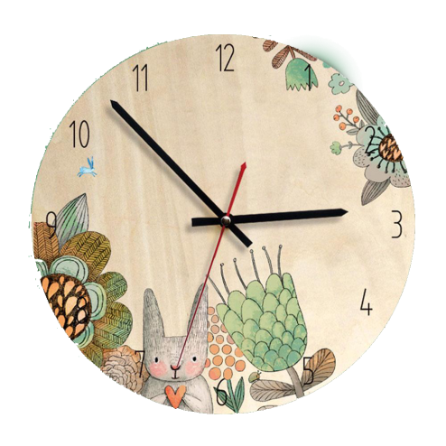
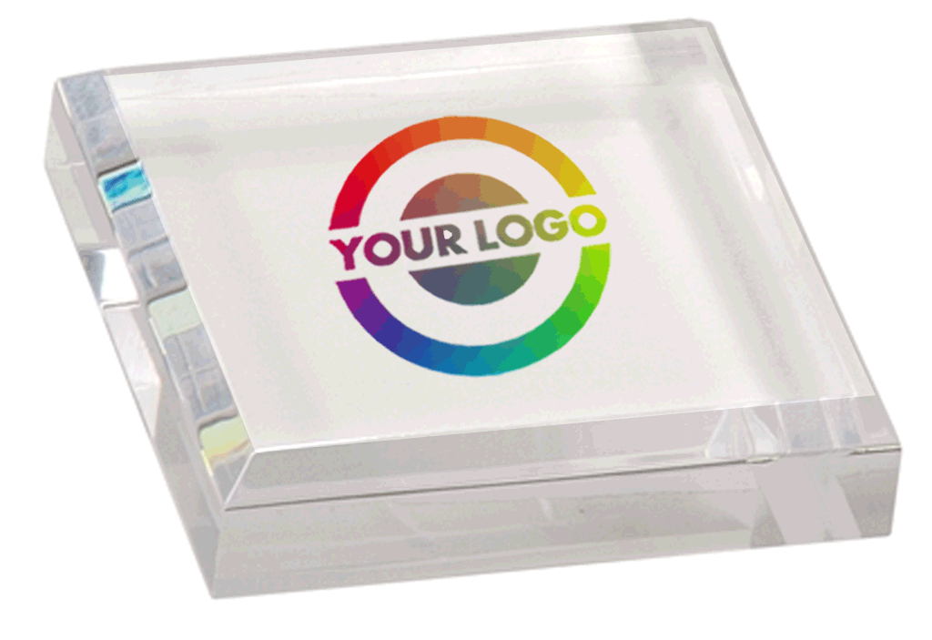
Customised Products
YOUR LOGO HERE
YOUR LOGO HERE
YOUR LOGO HERE
YOUR LOGO HERE
YOUR
LOGO HERE

Slide 11



Design and Printing
Whether from the scratch or working with existing designs, we offer bespoke creative solutions that
suit your brand. Our design team is always on hand to help your brand stand out. From Layouts to
Typesetting, content writing to copyediting, we have a dedicated team to assist you. You no longer require large quantities to print in full colour as we promise to offer a never before experience which ensures great quality products at an effective cost.

Slide 12
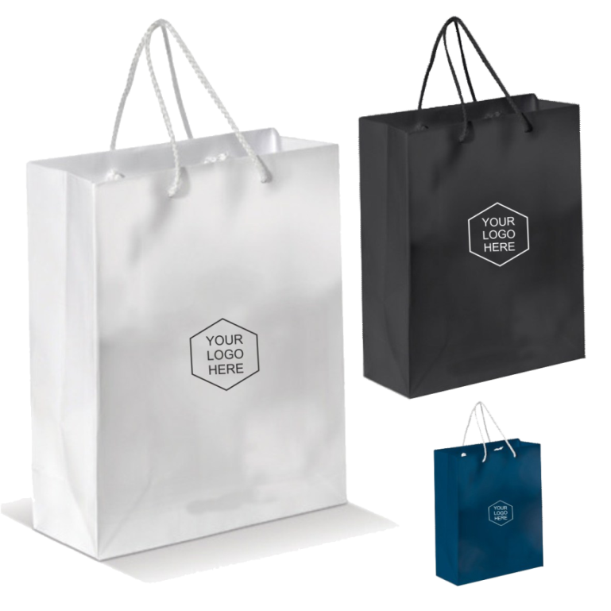
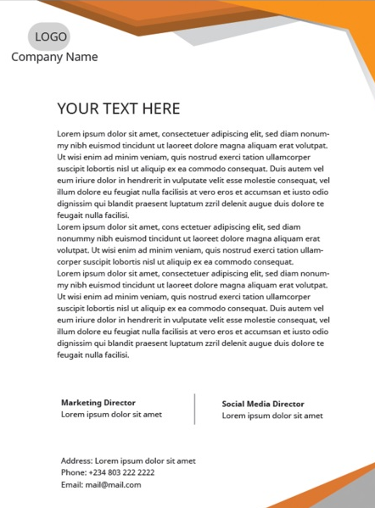
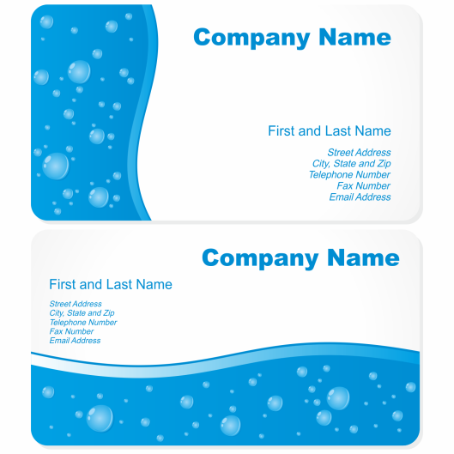
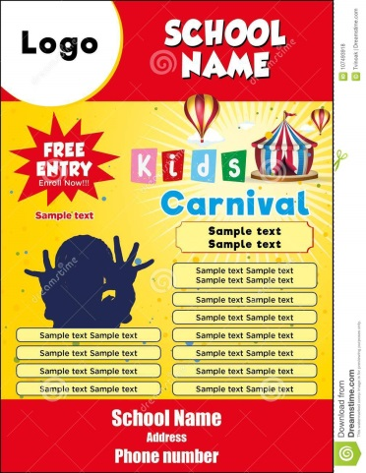
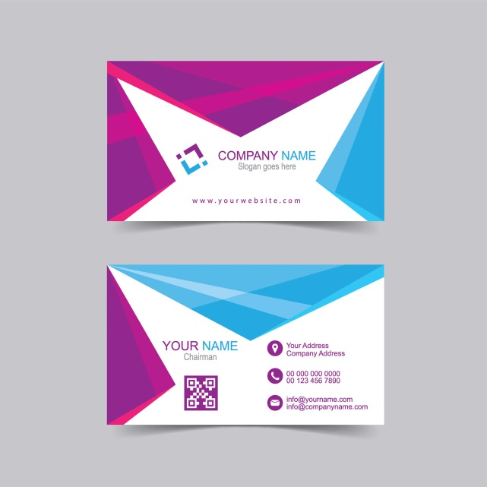
Design and Printing

Slide 13
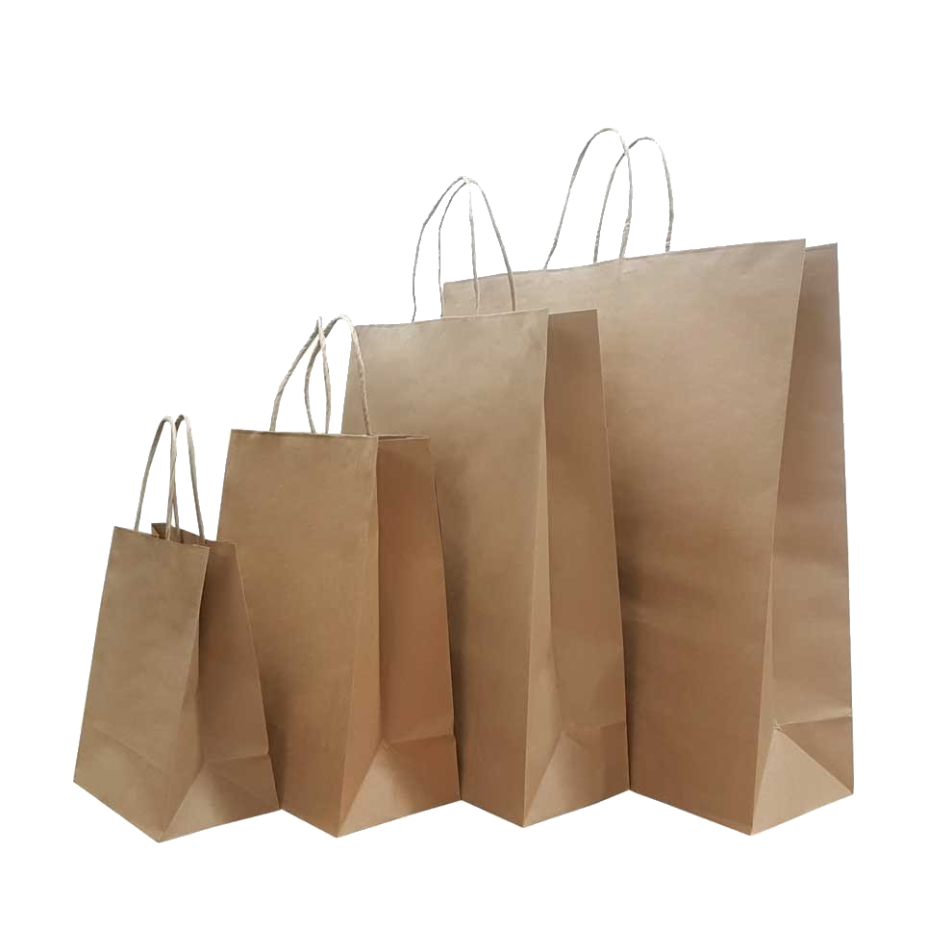
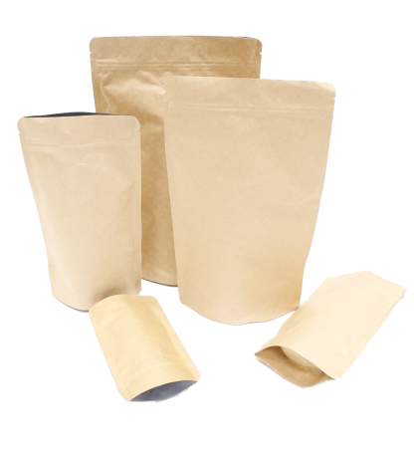
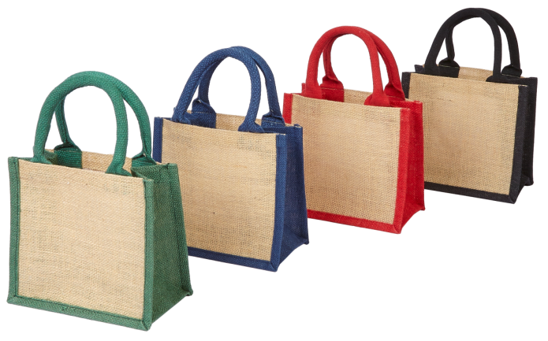
Eco- Friendly Item
We at Starmark believe in keeping our environment clean and healthy and make our country plastic free. So let’s all pledge to use eco-friendly products

Slide 14
Our USPs
01
02
03
Quality Results
Wide Range
Swift Turnaround
Our stern quality checks at every level of procurement, production, and packing makes sure that our clients are served with the best
.
We offer a wide range of products to select from, giving our customers the complete satisfaction of buying and choosing
We always endeavour to offer fast turnaround speeds that meet our customer’s crucial deadlines.

Slide 15
Our USPs
04
05
06
Affordable Pricing
Experienced People
Customer Service
We guarantee to provide the best of services at an affordable price to give our customers a never before experience
.
Our team work meticulously with businesses and organisations of all sizes to comprehend every detail, plan ahead and deliver excellent results.
Customer service is at the heart of what we do. We’re happy to help with any queries or assistance you may need, with expert and friendly advice always at hand

Slide 16
Contact Details
Contact us - 9990027722
Mail me – info@starmarksolution.com
Visit us @ starmarksolution.com
Thank you

